Slide 1
Principal Component Analysis
Lee-Ad Gottlieb

Slide 2
Dimension reduction
What was the goal of the JL-lemma?
Reduce dimension
Preserve inter-point distance
Principal Component Analysis
Reduce dimension
Minimize sum of distances to new dimension
Was the key component of winning the Netflix prize

Slide 3
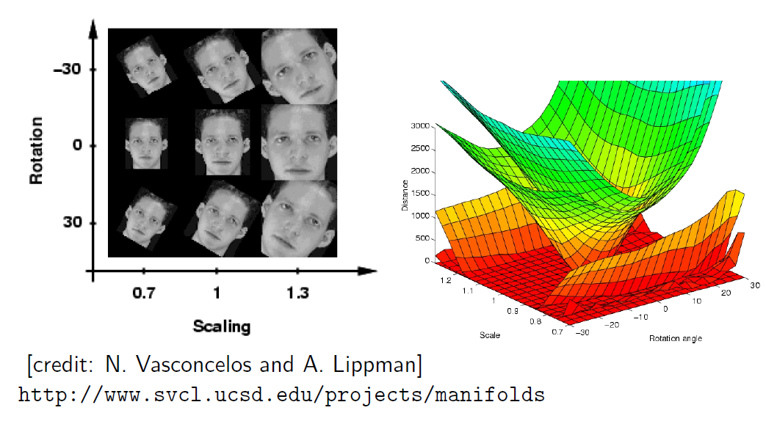
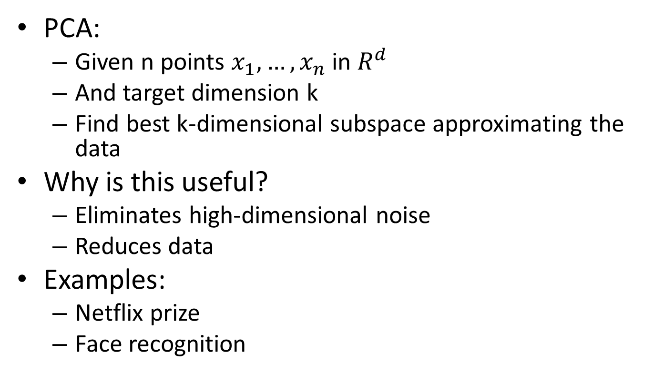
PCA
PCA:
Given n points $x_{1},…,x_{n}$ in $R^{d}$
And target dimension k
Find best k-dimensional subspace approximating the data
Why is this useful?
Eliminates high-dimensional noise
Reduces data
Examples:
Netflix prize
Face recognition

Slide 4
Principle Component Analysis
Minimize:
Sum of lengths of purple arrows

Slide 5
Principle Component Analysis
Difference between regression and PCA
Regression: Sum of squared distances to plane in y-direction
PCA: Sum of squared distances of points to plane
Regression
PCA

Slide 6
Principle Component Analysis
Difference between JL and PCA
JL: Worst-case distortion among new points
PCA: Sum of squared distances of original points to new points
JL
PCA

Slide 7
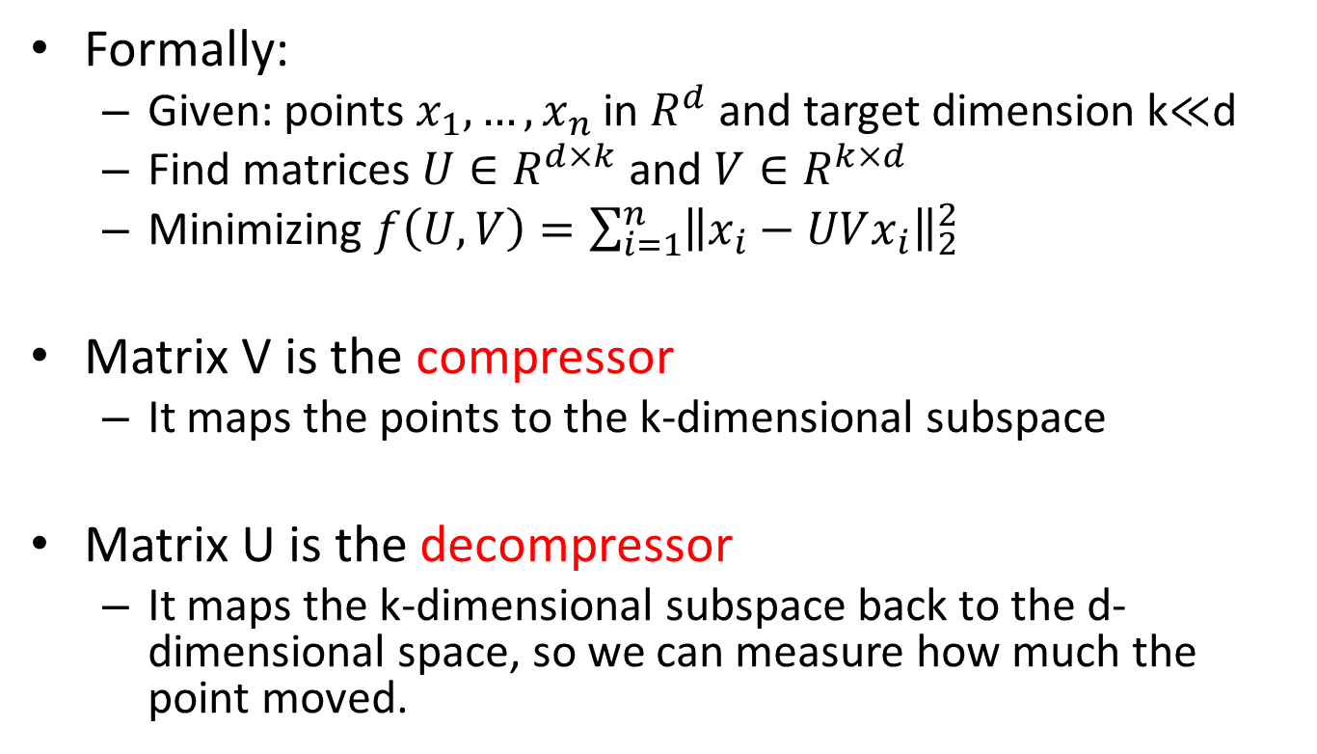
PCA
Formally:
Given: points $x_{1},…,x_{n}$ in $R^{d}$and target dimension k$≪$d
Find matrices $U∈R^{d×k}$ and $V∈R^{k×d}$
Minimizing $f\left(U,V\right)=\sum_{i=1}^{n}{{\left\|x_{i}−UVx_{i}\right\|}_{2}^{2}}$
Matrix V is the compressor
It maps the points to the k-dimensional subspace
Matrix U is the decompressor
It maps the k-dimensional subspace back to the d-dimensional space, so we can measure how much the point moved.

Slide 8
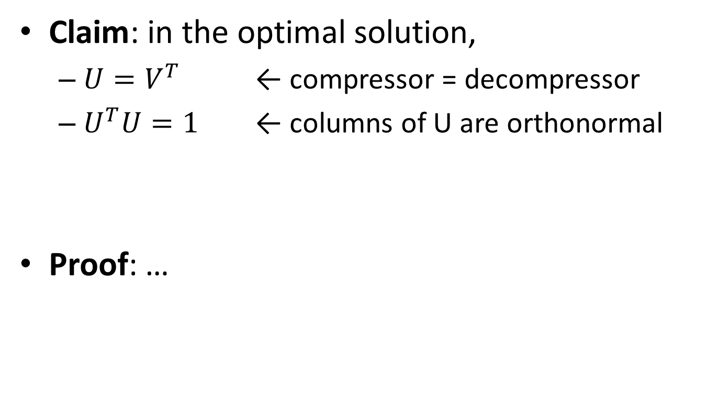
PCA
Claim: in the optimal solution,
$U=V^{T}$ ← compressor = decompressor
$U^{T}U=1$ ← columns of U are orthonormal
Proof: …

Slide 9
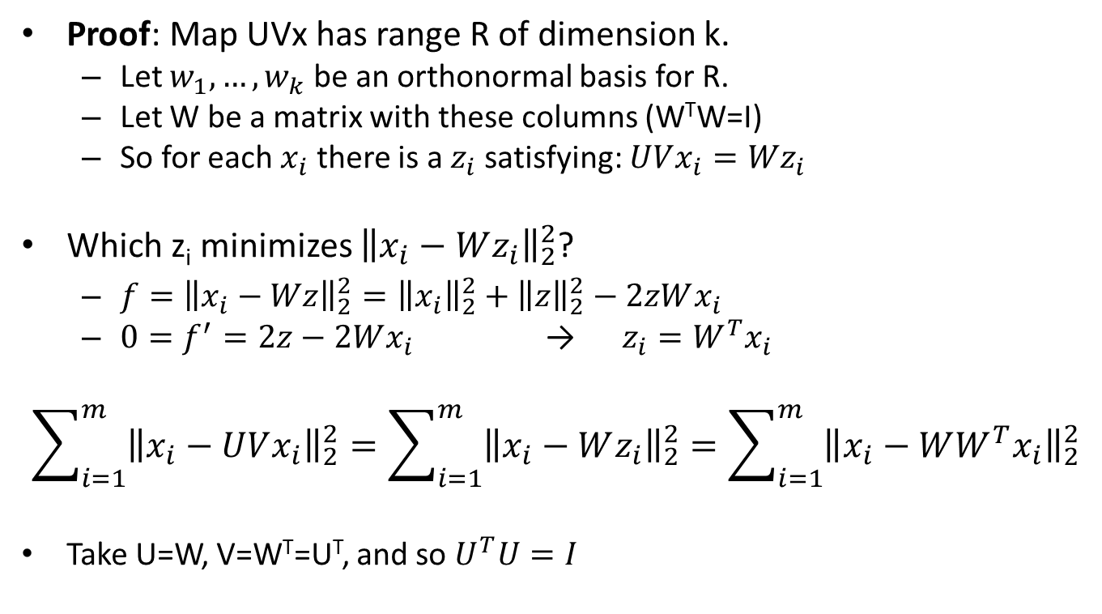
PCA
Proof: Map UVx has range R of dimension k.
Let $w_{1},…,w_{k}$ be an orthonormal basis for R.
Let W be a matrix with these columns (W^{T}W=I)
So for each $x_{i}$ there is a $z_{i}$ satisfying: $UVx_{i}={Wz}_{i}$
Which z_{i} minimizes ${\left\|x_{i}−Wz_{i}\right\|}_{2}^{2}$?
$f={\left\|x_{i}−Wz\right\|}_{2}^{2}={\left\|x_{i}\right\|}_{2}^{2}+{\left\|z\right\|}_{2}^{2}−2zWx_{i}$
${0=f}^{′}=2z−2Wx_{i}$ → $z_{i}=W^{T}x_{i}$
$$\sum_{i=1}^{m}{{\left\|x_{i}−UVx_{i}\right\|}_{2}^{2}}=\sum_{i=1}^{m}{{\left\|x_{i}−Wz_{i}\right\|}_{2}^{2}}=\sum_{i=1}^{m}{{\left\|x_{i}−WW^{T}x_{i}\right\|}_{2}^{2}}$$
Take U=W, V=W^{T}=U^{T}, and so $U^{T}U=I$

Slide 10
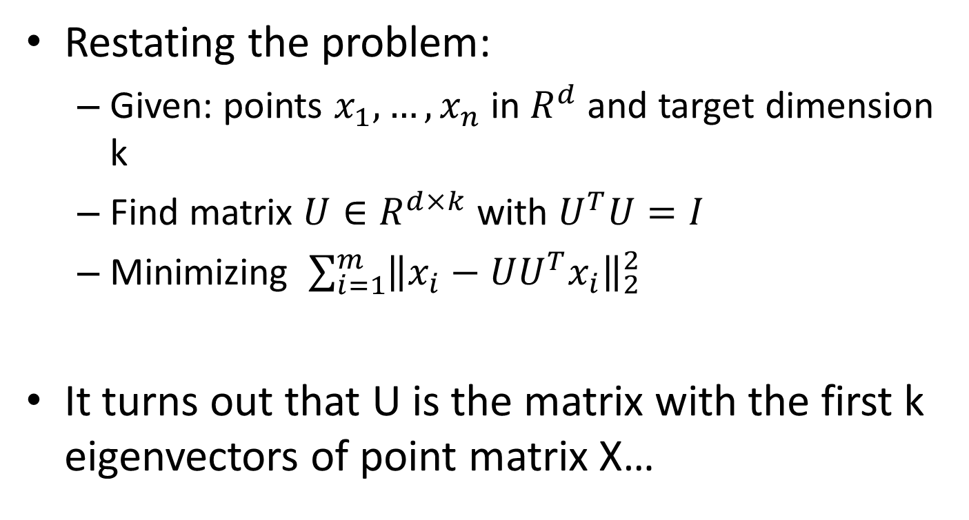
PCA
Restating the problem:
Given: points $x_{1},…,x_{n}$ in $R^{d}$and target dimension k
Find matrix $U∈R^{d×k}$ with $U^{T}U=I$
Minimizing $\sum_{i=1}^{m}{{\left\|x_{i}−UU^{T}x_{i}\right\|}_{2}^{2}}$
It turns out that U is the matrix with the first k eigenvectors of point matrix X…

Slide 11
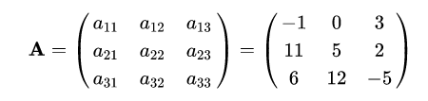
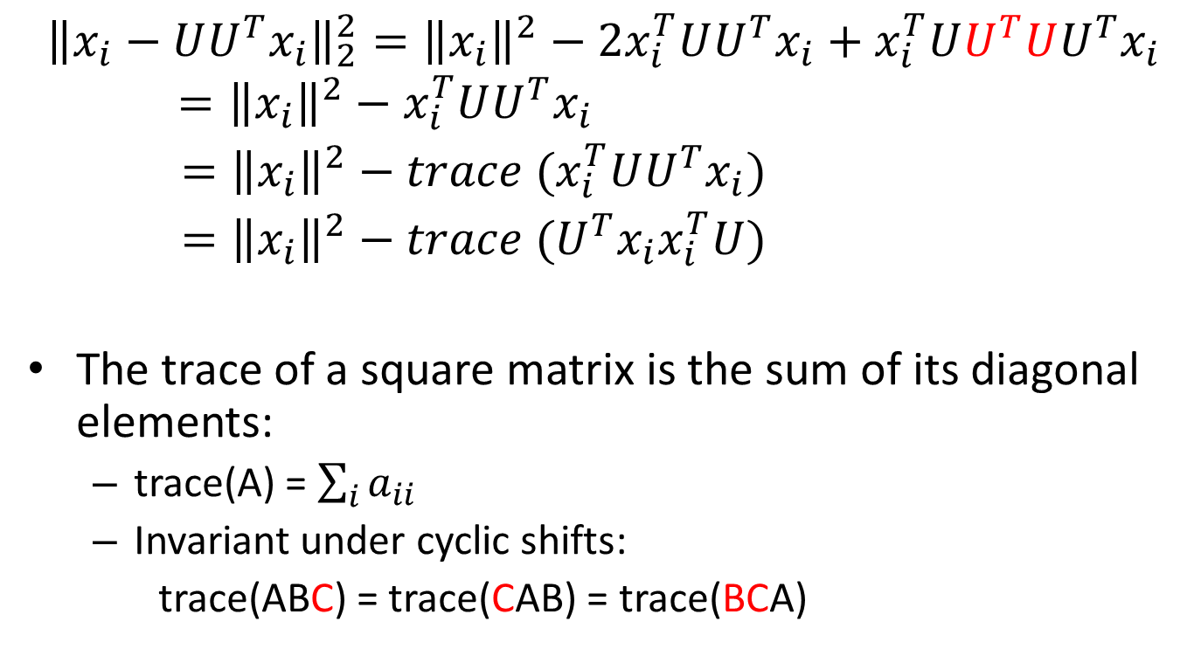
PCA
$${\left\|x_{i}−UU^{T}x_{i}\right\|}_{2}^{2}={\left\|x_{i}\right\|}^{2}−2x_{i}^{T}UU^{T}x_{i}+x_{i}^{T}UU^{T}UU^{T}x_{i}={\left\|x_{i}\right\|}^{2}−x_{i}^{T}UU^{T}x_{i}$$
$={\left\|x_{i}\right\|}^{2}−{trace (x}_{i}^{T}UU^{T}x_{i})$
$={\left\|x_{i}\right\|}^{2}−{trace (U^{T}x_{i}x}_{i}^{T}U)$
The trace of a square matrix is the sum of its diagonal elements:
trace(A) = $\sum_{i}{a_{ii}}$
Invariant under cyclic shifts:
trace(ABC) = trace(CAB) = trace(BCA)
scalar
matrix

Slide 12
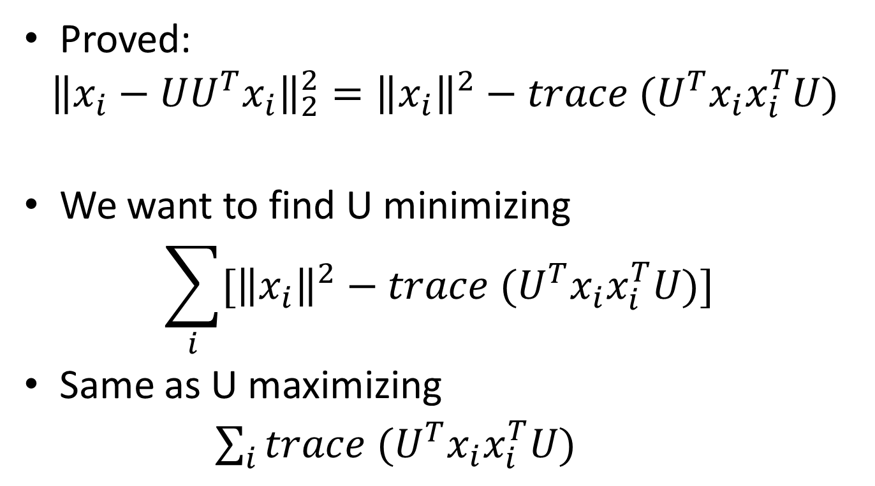
PCA
Proved:
$${\left\|x_{i}−UU^{T}x_{i}\right\|}_{2}^{2}={\left\|x_{i}\right\|}^{2}−{trace (U^{T}x_{i}x}_{i}^{T}U)$$
We want to find U minimizing
$$\sum_{i}{[{\left\|x_{i}\right\|}^{2}−{trace (U^{T}x_{i}x}_{i}^{T}U)] }$$
Same as U maximizing
$\sum_{i}{{trace (U^{T}x_{i}x}_{i}^{T}U)}$

Slide 13
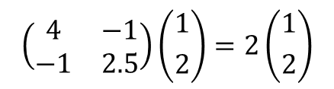
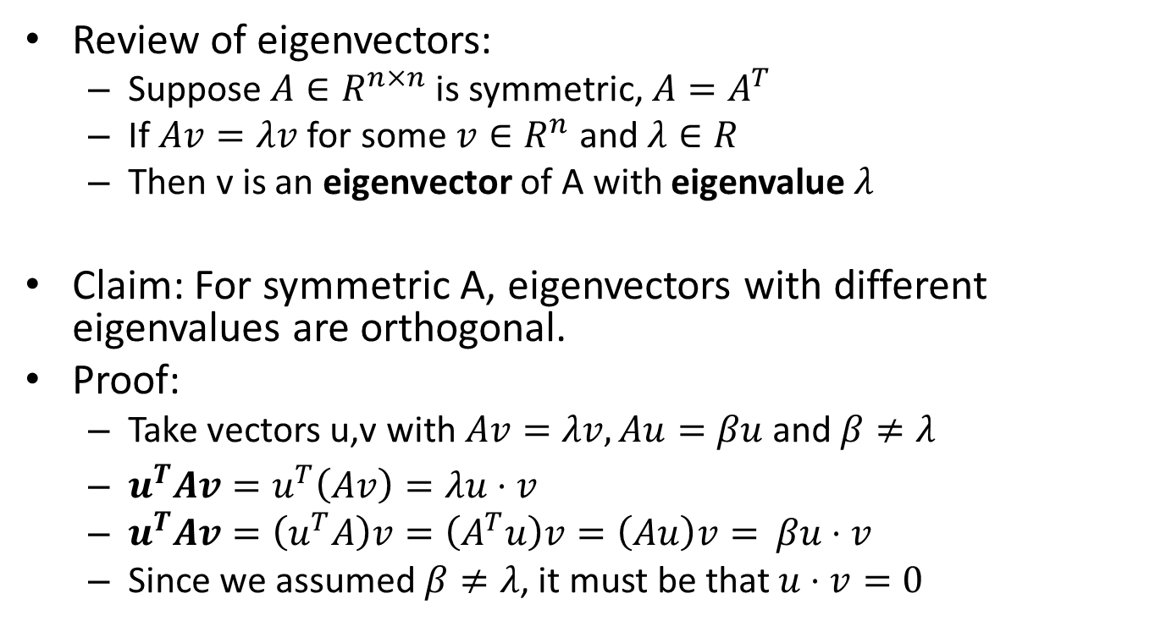
Eigenvectors
Review of eigenvectors:
Suppose $A∈R^{n×n}$ is symmetric, $A=A^{T}$
If $Av=λv$ for some $v∈R^{n}$ and $λ∈R$
Then v is an eigenvector of A with eigenvalue $λ$
Claim: For symmetric A, eigenvectors with different eigenvalues are orthogonal.
Proof:
Take vectors u,v with $Av=λv, Au=βu$ and $β≠λ$
$u^{T}Av=u^{T}\left(Av\right)=λu⋅v$
$u^{T}Av=\left(u^{T}A\right)v=\left(A^{T}u\right)v=\left(Au\right)v=$ $βu⋅v$
Since we assumed $β≠λ$, it must be that $u⋅v=0$
$$\left(\begin{matrix}4 & −1 \\ −1 & 2.5\end{matrix}\right)\left({1 \atop 2}\right)=2\left({1 \atop 2}\right)$$

Slide 14

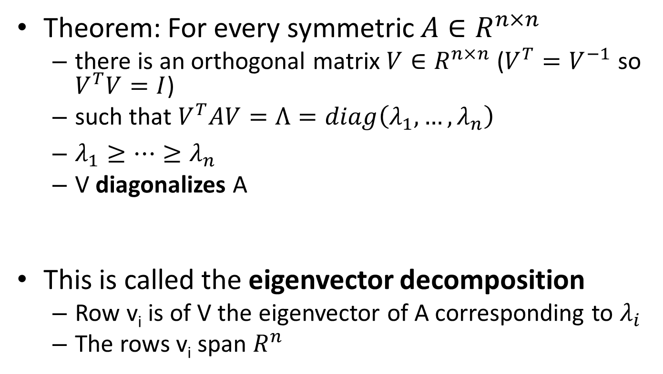

Eigenvectors
Theorem: For every symmetric $A∈R^{n×n }$
there is an orthogonal matrix $V∈R^{n×n}$ ($V^{T}=V^{−1}$ so $V^{T}V=I$)
such that $V^{T}AV=Λ=diag\left(λ_{1},…,λ_{n}\right)$
$λ_{1}≥…≥λ_{n}$
V diagonalizes A
This is called the eigenvector decomposition
Row v_{i} is of V the eigenvector of A corresponding to $λ_{i}$
The rows v_{i} span $R^{n}$
$$\left(\begin{matrix}λ_{1} & 0 \\ 0 & λ_{2}\end{matrix}\right)$$
$Λ$ =

Slide 15
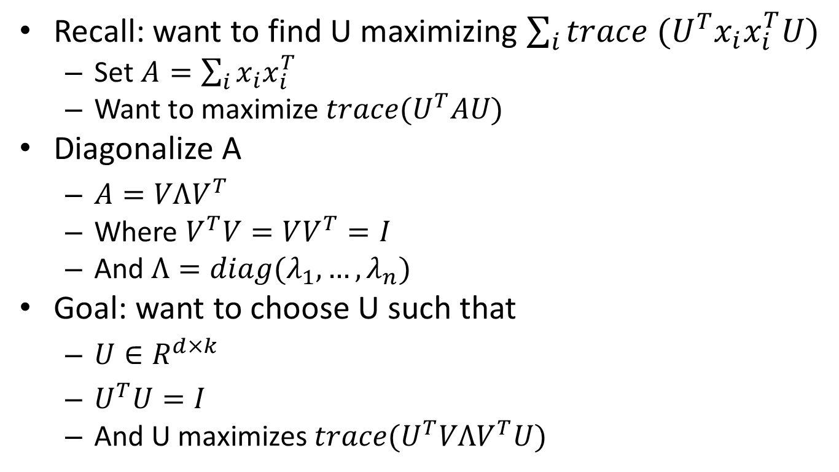

PCA
Recall: want to find U maximizing $\sum_{i}{{trace (U^{T}x_{i}x}_{i}^{T}U)}$
Set $A=\sum_{i}{x_{i}x_{i}^{T}}$
Want to maximize $trace(U^{T}AU)$
Diagonalize A
$A=VΛV^{T}$
Where $V^{T}V=VV^{T}=I$
And $Λ=diag(λ_{1},…, λ_{n})$
Goal: want to choose U such that
$U∈R^{d×k}$
$U^{T}U=I$
And U maximizes $trace(U^{T}VΛV^{T}U)$
$$\left(\begin{matrix}λ_{1} & 0 \\ 0 & λ_{2}\end{matrix}\right)$$
$Λ$ =

Slide 16
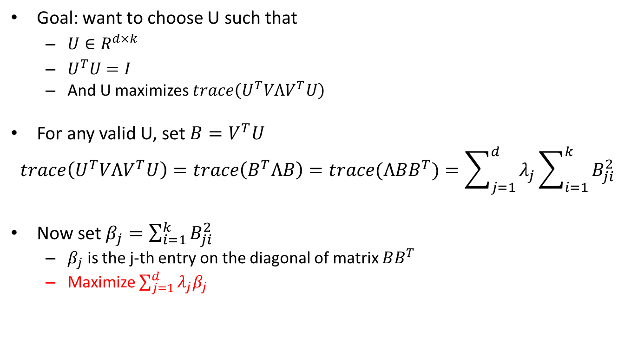
PCA
Goal: want to choose U such that
$U∈R^{d×k}$
$U^{T}U=I$
And U maximizes $trace\left(U^{T}VΛV^{T}U\right)$
For any valid U, set $B=V^{T}U$
$$trace\left(U^{T}VΛV^{T}U\right)=trace\left(B^{T}ΛB\right)=trace(ΛBB^{T})=\sum_{j=1}^{d}{λ_{j}\sum_{i=1}^{k}{B_{ji}^{2}}}$$
Now set$β_{j}=\sum_{i=1}^{k}{B_{ji}^{2}}$
$β_{j}$ is the j-th entry on the diagonal of matrix $BB^{T}$
Maximize $\sum_{j=1}^{d}{{λ_{j}β}_{j}}$

Slide 17
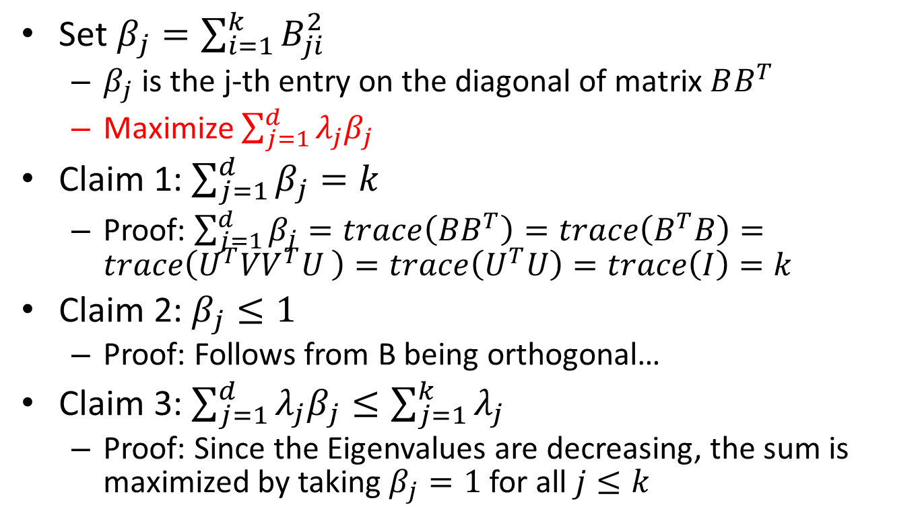
PCA
Set$β_{j}=\sum_{i=1}^{k}{B_{ji}^{2}}$
$β_{j}$ is the j-th entry on the diagonal of matrix $BB^{T}$
Maximize $\sum_{j=1}^{d}{{λ_{j}β}_{j}}$
Claim 1: $\sum_{j=1}^{d}{β_{j}=k}$
Proof: $\sum_{j=1}^{d}{β_{j}}=trace\left(BB^{T}\right)=trace\left(B^{T}B\right)=trace\left({U^{T}VV}^{T}U \right)=trace\left(U^{T}U\right)=trace\left(I\right)=k$
Claim 2: $β_{j}≤1$
Proof: Follows from B being orthogonal…
Claim 3: $\sum_{j=1}^{d}{{λ_{j}β}_{j}≤\sum_{j=1}^{k}{λ_{j}}}$
Proof: Since the Eigenvalues are decreasing, the sum is maximized by taking $β_{j}=1$ for all $j≤k$

Slide 18
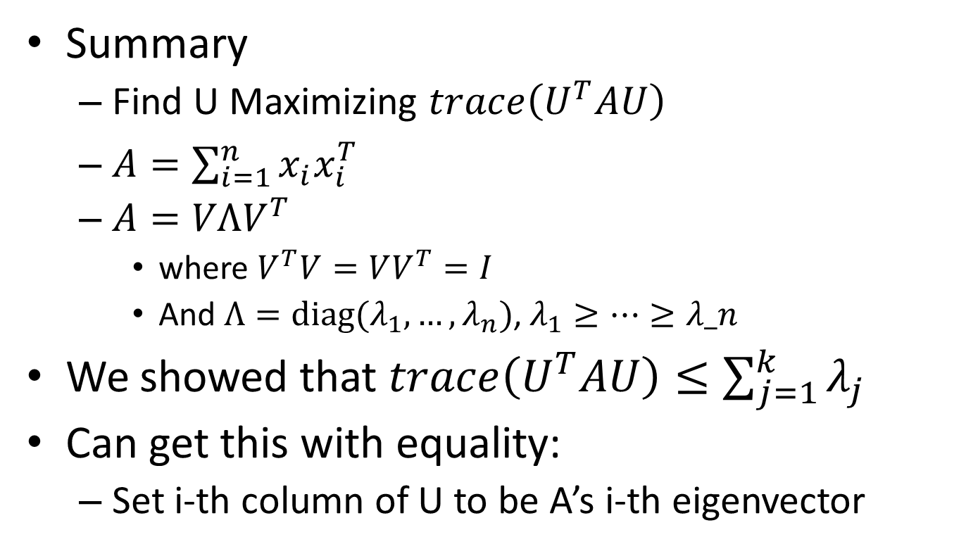
PCA
Summary
Find U Maximizing $trace\left(U^{T}AU\right)$
$A=\sum_{i=1}^{n}{x_{i}x_{i}^{T}}$
$A=VΛV^{T}$
where $V^{T}V=VV^{T}=I$
And $Λ=diag(λ_{1},…,λ_{n})$, $λ_{1}≥…≥λ_n$
We showed that $trace\left(U^{T}AU\right)≤\sum_{j=1}^{k}{λ_{j}}$
Can get this with equality:
Set i-th column of U to be A’s i-th eigenvector

